Slide 1
Audio Harmonizer
Annie Rizvi
Nina Rao
Jason Dimelow
Urinrinoghene Lauretta Omughelli

Slide 2
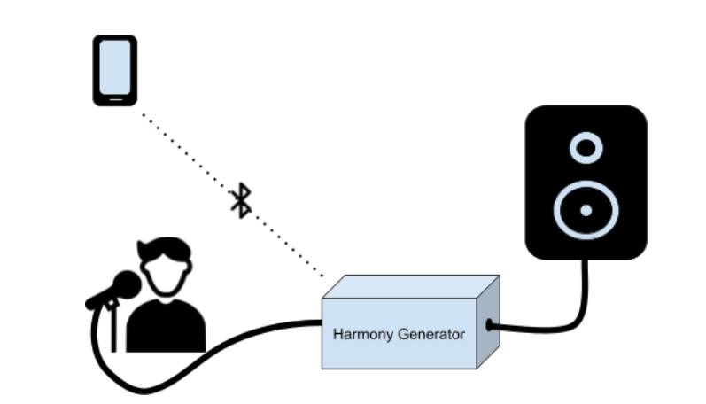
Project Statement
Create a system that allows artists to create multiple harmonies in real time for performances.
Notes:
Jason

Slide 3
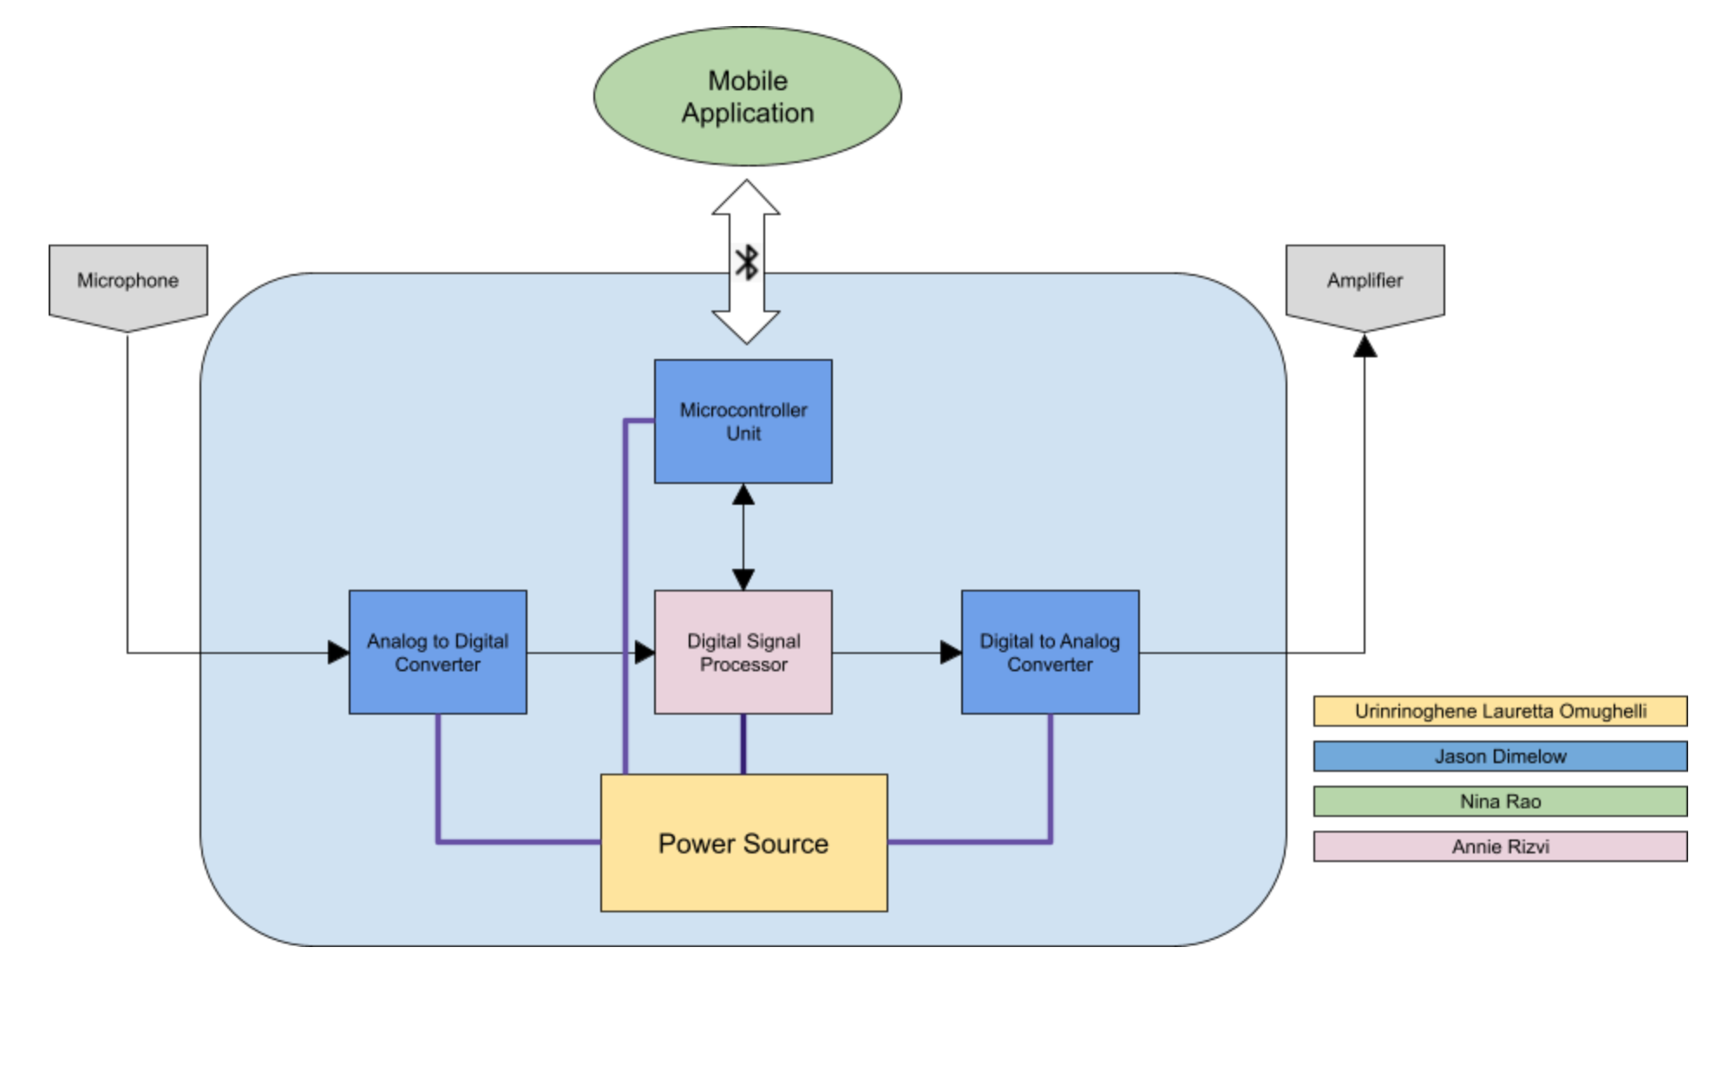
Project Subsystems
Notes:
Nina:

Slide 4
Project Current Timeline
Integrating DSP Algorithms on to Real-Time MCU
MCU and Android Application Bluetooth Communication Complete
Fuel Gauge Integration in Progress
Main PCB Design in Progress
Power Supply PCB Reordered

Slide 5
Subsystem 1: Digital Signal Processor
Accomplishments Since Last Presentation <45 hrs> | Ongoing progress/problems and plans until next presentation
Met with TI Support Refactored project | Complete refactoring Integrate Harmonies Receive user input from MCU

Slide 6
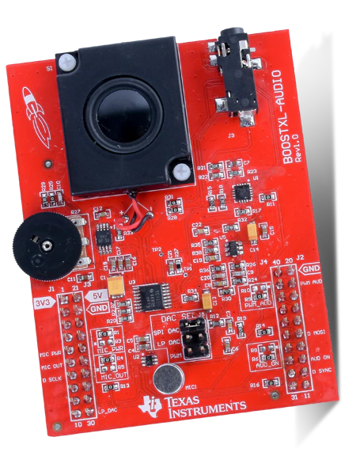
Digital Signal Processor
2 DMA Channels taking Audio input in ping-pong format
Timer set to 20kHz for ADC and DAC input/output
Close to completing continuous audio record and playback
Meeting with TI Support set for tomorrow

Slide 7
Microcontroller Unit
Main Unit Schematic/PCB
Accomplishments Since Last Presentation <5 hrs> | Ongoing progress/problems and plans
MCU Testing from last semester complete Communication with App via bluetooth working fully | Communication with DSP Working on I2C communication with Battery Fuel Gauge
Accomplishments Since Last Presentation <15 Hrs> | Ongoing progress/problems and plans until next presentation
Soldered most of old design PCB | Will be attempting redesign with new MSP430 chip for audio in/out
Notes:
MCU will be relaying data to and fro the dsp/user interface via bluetooth. Telling the DSP what type of harmony the user wants, and then sending the digital to back to the app...

Slide 8
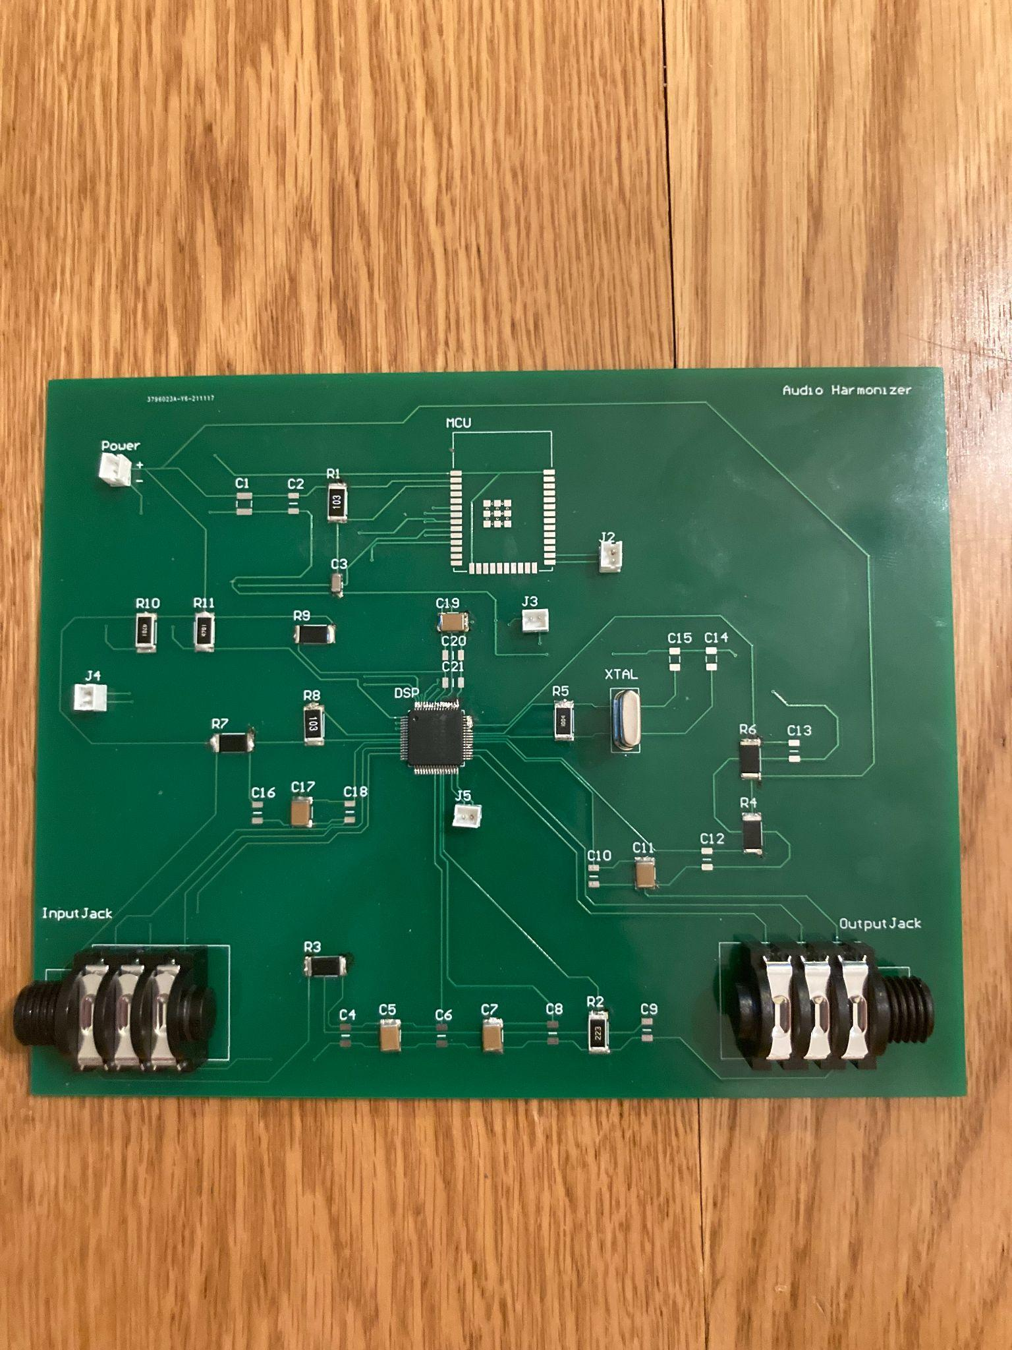
PCB Design
Need to add missing capacitors
Likely will redesign with MSP430

Slide 9
Power Supply and Integration with MCU I2C Communication
Accomplishments Since Our Last Presentation <10 hrs> | Ongoing progress/problems and plans until next presentation
Tested PCB functionality Fuel gauge I2C programming for Integrating with MCU subsystem | PCB short circuit issue due to clearance rule violation being diabled in Altium Issue resolved and PCB reordered Test I2C communication with ESP 32

Slide 10
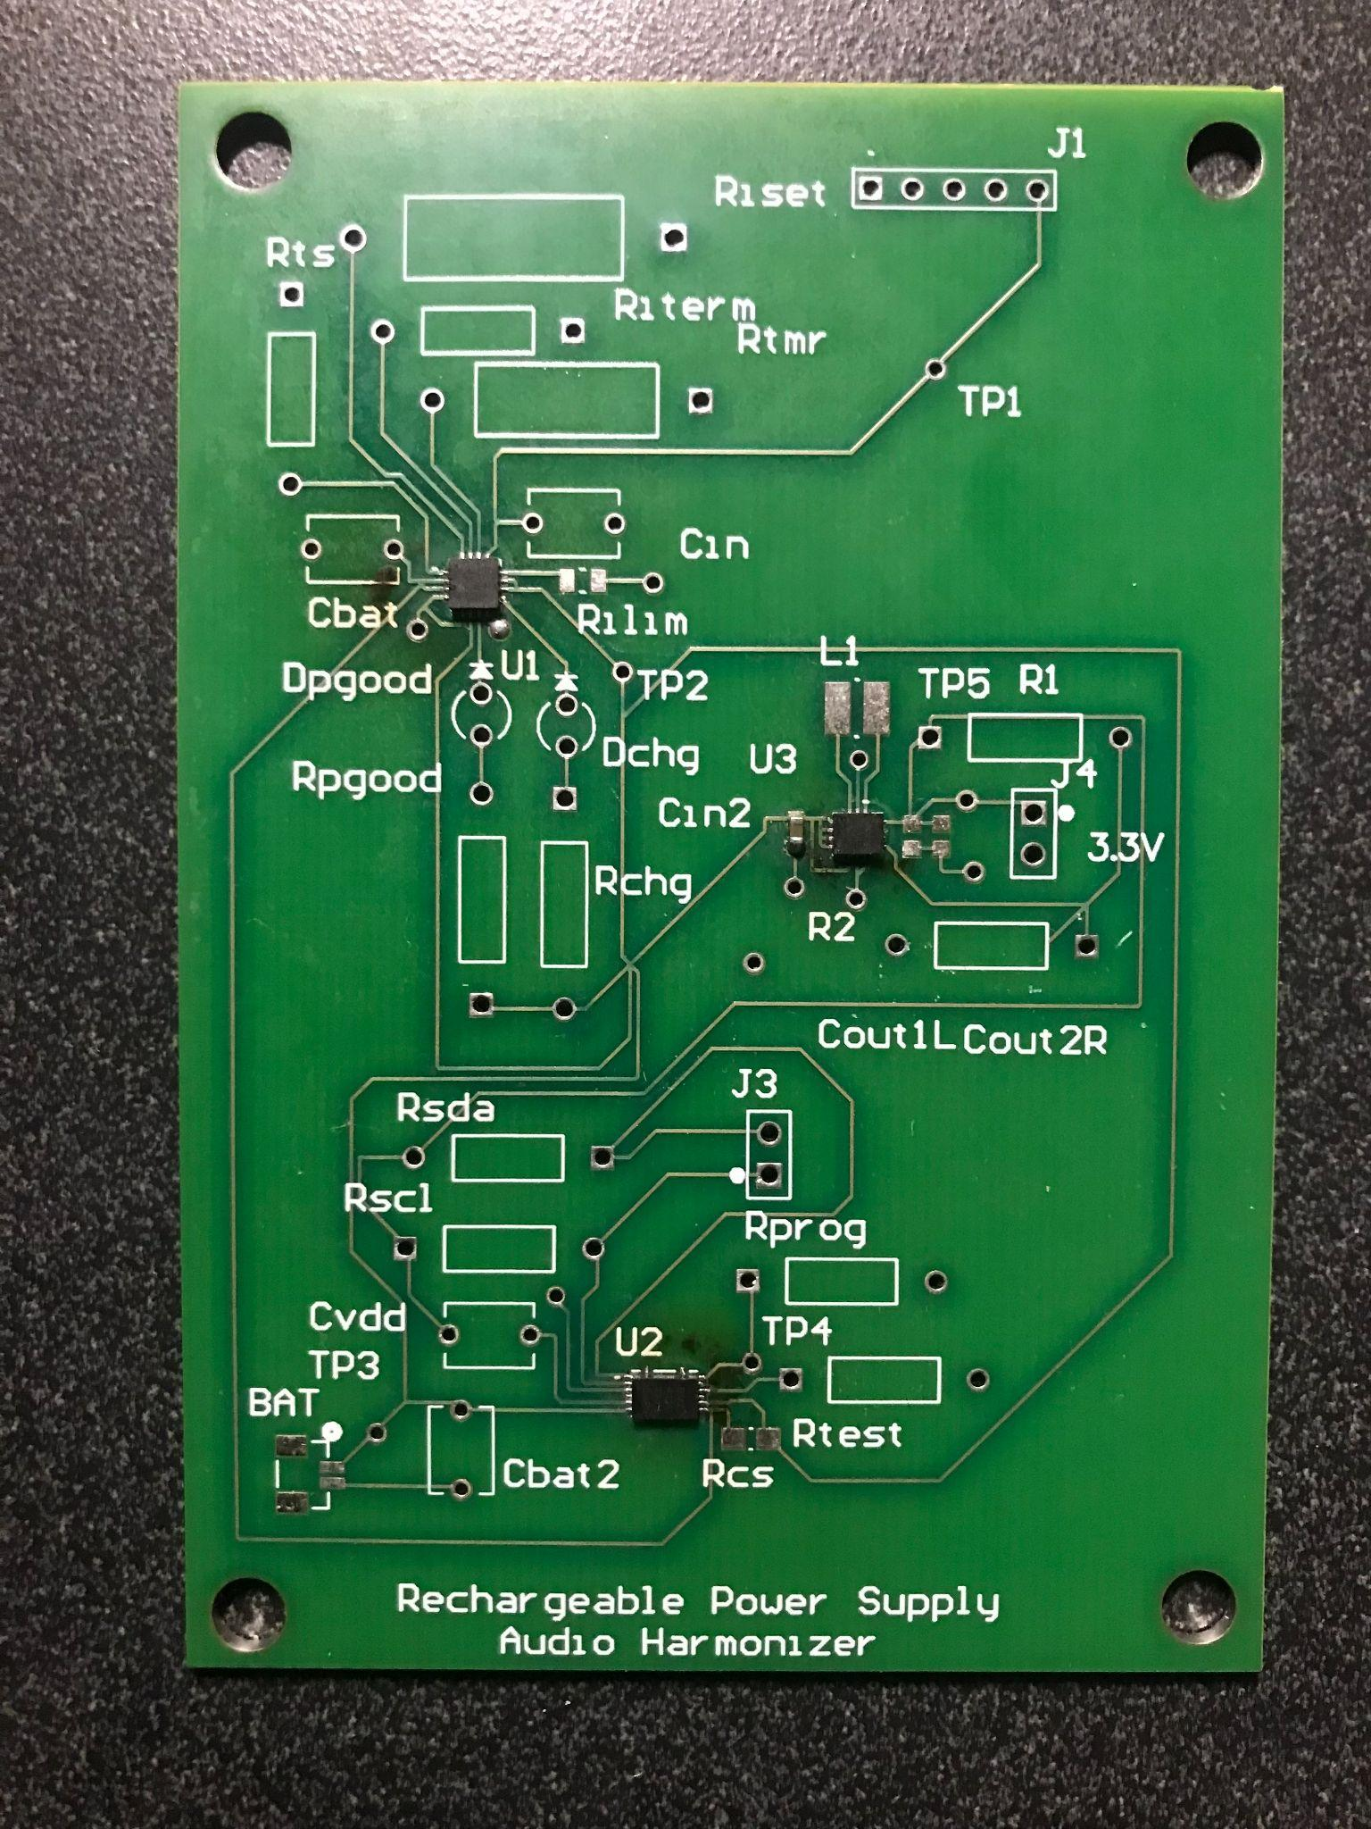
Power Supply PCB

Slide 11
Fuel Gauge Reading
Lauretta & Annie
Arduino Library for BQ27411
Should work with BQ27441
Arduino Code written to read I2C data for:
State of charge
Voltage
Current
Re-test once parts are completely soldered

Slide 12
Bluetooth Communication
Jason & Nina
MCU and Android App Connect via Bluetooth
Android App able to send user inputs as string
MCU Arduino Code able to receive and interpret user input into corresponding variables for manual and automatic modes
Android App is able to receive battery level from the MCU and display it accordingly

Slide 13
Parts Ordering Status
Main PCB needs to be ordered

Slide 14
Progress

Slide 15
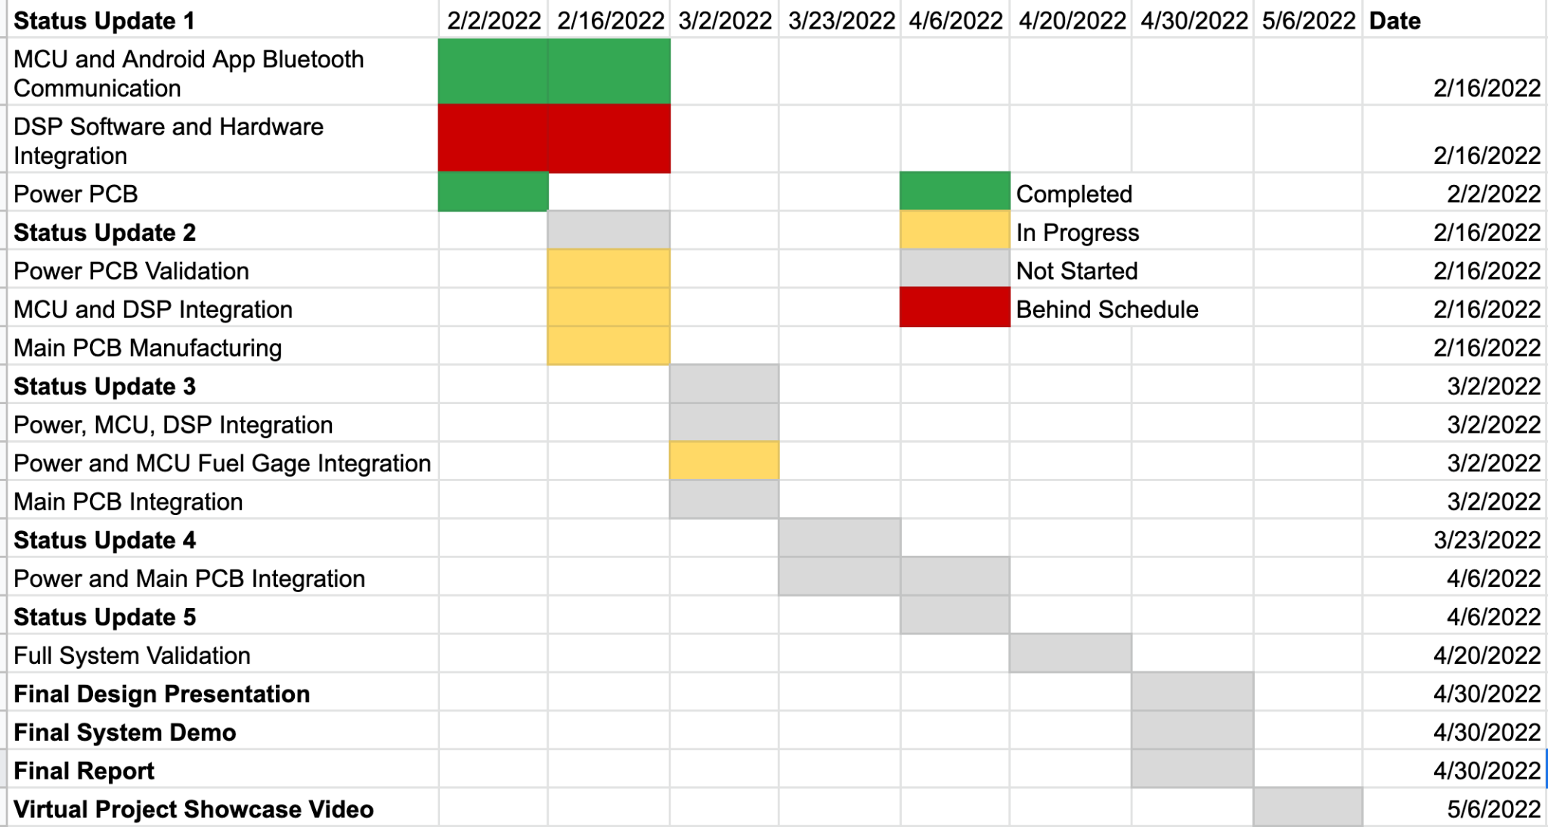
Execution Plan

Slide 16
Validation Plan
Paragraph # | Test Name | Success Criteria | Methodology | Status | Resp. Engineers
3.2.1.2 | MCU, Android App Bluetooth Communication | Android able to successfully send the mode, number of harmonies and additional necessary information to ESP32 MCU which is visible and interpretable by the ESP32 terminal | App connects via bluetooth and sends sample user data | PASSED | Nina Rao, Jason Dimelow
3.2.1 | DSP with ADC/DAC Hardware Integration | Able to receive sample audio in real time and harmonize with specific chord progression which is output through DAC | Use TI Real time MCU Launchpad and Audio Booster Pack | UNTESTED | Annie Rizvi
3.2.3.1.4 | DSP and MCU Communication | DSP receives fake user input from MCU via input pins and is interpretable | Use ESP32 and TI MCU Launchpad LEDs to verify input | UNTESTED | Annie Rizvi, Jason Dimelow
3.2.3.1.3 | Fuel Gage, MCU, Android App Communication | Android App displays battery voltage and state of charge. | Programming of the MCU to communicate with the fuel gauge through I2C | UNTESTED | Lauretta Omughelli, Jason Dimelow
3.2.1.2 | Android, MCU, DSP Seamless Communication | User inputs values via application which is sent through MCU to DSP to run correct harmonizing algorithm in real time | Use Ti Real time MCU Launchpad and Audio Booster Pack connected to ESP32 | UNTESTED | Nina Rao, Jason Dimelow, Annie Rizvi
3.2.3.1.2 | Input Voltage for Subsystems | All subsystems properly powered through rechargable battery | Use voltmeter to ensure voltage values match requirements | UNTESTED | Lauretta Omughelli
3.2.1 | Full System Functionality | User able to use Audio Harmonizer that is powered by rechargeable battery for real time harmonization | Team member pretends to be user with instrument or singing into mic connected to Audio Harmonizer, using App on Android Phone | UNTESTED | Nina Rao, Jason Dimelow, Lauretta Omughelli, Annie Rizvi

Slide 17
Questions?

